Slide 1

Alvaro Crego

Slide 2
Libraries
To work the effects have to import jquery and bootstrap libraries.
You may also have to import the libraries as modal.js, popover.js, etc ...

Slide 3
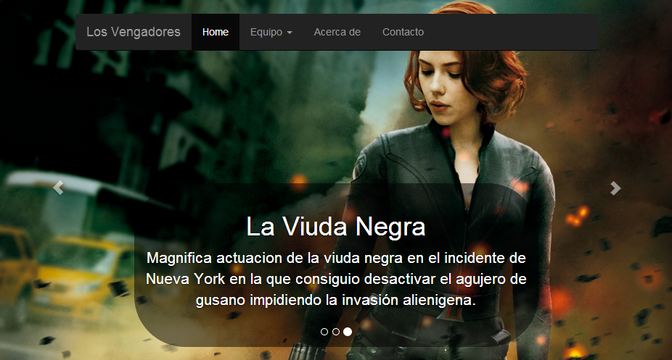
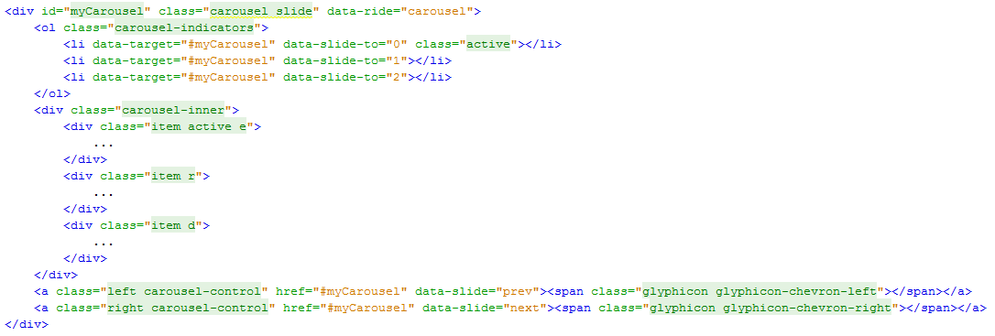
Carousel
The code is very simple. The only setting is to change the images path.

Slide 4
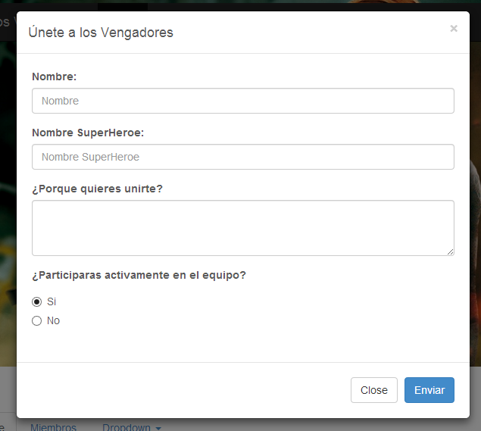
Modal
The modal code is very simple too. The only setting is to change the id to distinguish them.

Slide 5
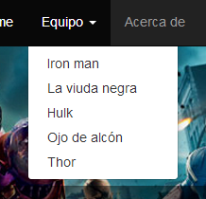
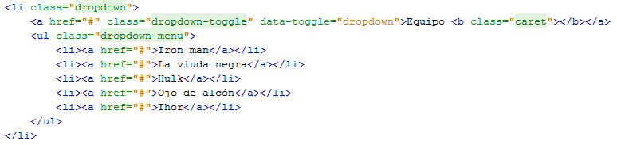
Dropdown
To include a dropdown, just add the following code(To make a dropdown have to put this code.)

Slide 6
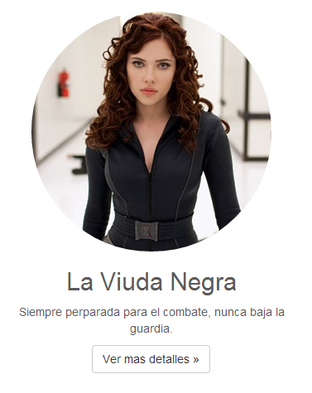
Images
To achieve this effect just add the class "img-circle" to the image.

Slide 7
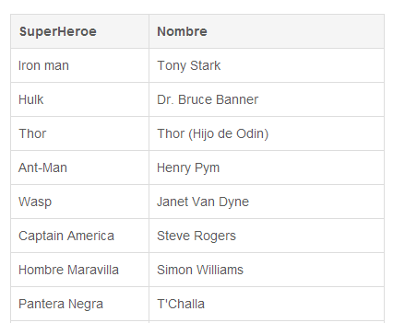
Tables hover and bordered
To this effect just add the class "table-bordered" and "table-hover" to the table.

Slide 8

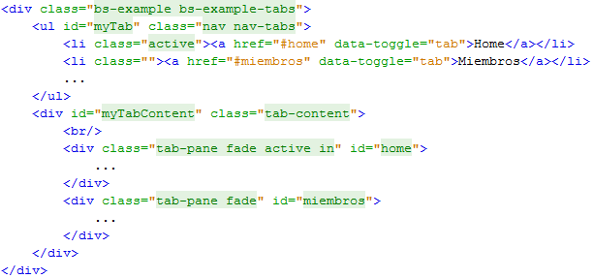
Tab
You have to be careful with the name of the id. The link must have the id of modal you want to activate.

Slide 9
The Website:
http://alvarocrego.hol.es/

